Slide 1

Discover the Magic of MALI TRACK.
Notes:
1

Slide 2

SMB owners in Africa struggle with managing finances and inventory effectively, leading to poor decision-making, reduced profitability, and financial instability and insights perpetuates poverty and hinders sustainable growth.
Small and medium-sized business owners across Africa often lack access to tools for managing money and inventory effectively. This leads to untracked expenses, reduced profits, and financial instability, making it harder to escape poverty. By addressing these challenges, they can achieve sustainable growth and economic empowerment.
Notes:
2

Slide 3

Our Solution .
Our app empowers small and medium-sized business owners in Africa with an all-in-one tool to manage their money, track income and expenses, and oversee inventory seamlessly. By providing clear insights and financial control, the app helps users maximize profits, make informed decisions, and achieve sustainable growth—ultimately breaking the cycle of poverty and fostering economic empowerment.
Notes:
3

Slide 4



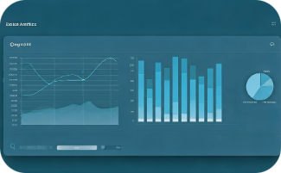


Our Product will :
Financial Management
Inventory Management
Budget Planning
Analytics & Reporting
Track income with user-friendly dashboards that provide clear financial insights.
Monitor stock levels, manage inventory costs, and ensure supply efficiency.
Set and manage budgets to avoid overspending and allocate resources effectively.
Generate actionable reports and insights to support informed decision-making.
Profit Optimization
Accessibility
Highlight areas for improvement and opportunities to maximize profits.
Intuitive design tailored for users with minimal technical expertise.
Notes:
4

Slide 5



Target Market
3 out of 5 SMBs
95% Understand Value
20 Million SMBs
Do not properly track profits, spending, and inventory.
Recognize record-keeping is important but find it tedious and prone to procrastination.
Will increase earnings by more than one-third; 5 million will more than double profits.
Notes:
5

Slide 6
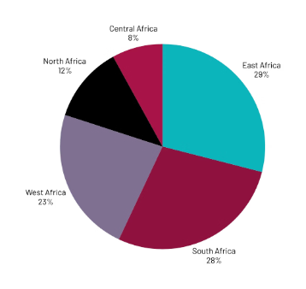
Market Size
Kenya's market is fueled by its vibrant SMB sector, which constitutes about 80% of businesses. However, these businesses face a financing gap of approximately KES 2.2 trillion ($19.3 billion).This gap highlights the demand for tools that streamline financial and inventory management.
Africa (Segmented by Region)
1. North Africa: A region with strong economic hubs like Egypt and Morocco, where SMBs are increasingly adopting digital solutions to enhance operational efficiency.
2. South Africa: Home to a well-developed SMB ecosystem, with significant demand for inventory and financial management tools to support growth.
3. East Africa: Includes Kenya, Uganda, and Tanzania, where SMBs are rapidly embracing technology to overcome financial and inventory challenges.
4. West Africa: Countries like Nigeria and Ghana are seeing a surge in SMBs seeking digital tools to manage finances and inventory effectively.
5. Central Africa: A developing market with growing interest in digital solutions, particularly in countries like Cameroon and the Democratic Republic of Congo.
Notes:
6

Slide 7

Competitors
1. QuickBooks:
- Why ours is Better: QuickBooks focuses heavily on financial tools like bookkeeping and invoicing but doesn't integrate inventory management and profit optimization in a seamless way. Our app stands out by combining these features with a mission to empower SMB owners in Africa, addressing not just operational efficiency but also poverty alleviation.
2. Zoho Books:
- Why ours is Better: Zoho Books offers inventory tracking, but it lacks a localized approach tailored to African SMBs. Our app's focus on the specific needs of African markets, such as affordability, accessibility, and targeted insights for combating poverty, makes it a more impactful solution.
3. Xero:
- Why ours is Better: While Xero provides advanced financial and inventory tools, it's designed primarily for larger or more established businesses in developed markets. Our app differentiates itself by being SMB-friendly, intuitive for users with minimal technical expertise, and aligned with the unique challenges faced by African entrepreneurs.
Notes:
7

Slide 8
Competitive Advantage
1. Localized Focus: Tailored specifically to African markets, addressing unique challenges SMBs face in the region.
2. Comprehensive Integration: Combines financial management, profit optimization, expenditure tracking, and inventory control in a single app.
3. User-Friendly Design: Intuitive interface designed for users with varying levels of technical expertise.
4. Affordability: Priced to remain accessible to small and medium-sized business owners.
5. Social Impact Mission: Goes beyond operations to empower users by combating poverty and fostering economic growth.
6. Actionable Insights: Provides advanced analytics and reports that help SMBs make informed decisions.
7. Scalability: Designed to grow with businesses, offering flexibility for both small enterprises and those expanding their reach.
8. Accessibility: Offline functionality or minimal data requirements, ensuring usability in areas with limited internet access.
9. Holistic Financial View: Tracks and connects income, expenses, inventory, and profits seamlessly for a complete picture.
10. Local Language Support: Options for multiple African languages to enhance inclusivity and accessibility.
Notes:
8

Slide 9








Project Traction
Concept and Planning
Market Research
Design and Prototyping
Development
Defining goals and initial strategies for success: January - March 25
Analyzing needs and opportunities within target markets: February 25
Developing user-friendly product models and interfaces: Feb - Sep 25
Building the core technology and application features: March - Oct 25
Testing and Refinement
Launch Strategy
Marketing and Outreach
Monitoring and Updates
Ensuring performance, fixing bugs, and improving usability: Aug - Oct 25
Preparing for product introduction to the market: Oct - Nov 25
Engaging customers and spreading awareness: Sep - Nov 25
Maintaining and improving post-launch performance: Sep - Nov 25
Notes:
9

Slide 10


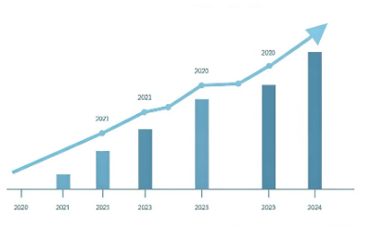

Freemium Business Model.
User Base
Pricing
Annual Revenue
Costs & Profit
100,000 users in year one, with 10,000 premium subscribers
$5 monthly subscription fee per premium user
$600,000 from premium subscriptions
$300,000 costs yield $300,000 profit annually
Notes:
10

Slide 11

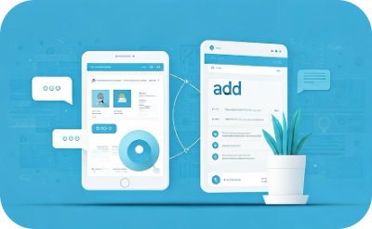

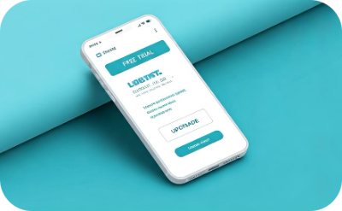
Go To Market
Referral Programs: Reward users who invite others with discounts or extended trials.
Digital Marketing: Use targeted online ads on Google, Facebook, and Instagram to reach SMBs.
Localized Outreach: Incorporate local languages and culturally relevant branding.
Free Trials & Freemium: Attract users with basic free features and premium upsells.
Notes:
11

Slide 12




Social Impact
No Poverty
Decent Work & Economic Growth
Reduced Inequalities
Industry, Innovation & Infrastructure
Helping combat poverty through increased profitability and sustainable growth.
Providing tailored tools and resources for SMBs in underserved regions.
Encouraging entrepreneurship and supporting small businesses to drive economic growth.
Promoting innovation to improve SMB operations and build resilient African businesses.
Notes:
12

Slide 13





Our Ask: $30,000 Funding
App Design and Development
Testing and Bug Fixes
Marketing and Outreach
Launch Strategy Execution
$18,000 for building MaliTrack app features
$3,000 to ensure quality and performance
$5,000 to reach SMB customers across Africa
$2,000 for a successful product introduction
Operational Costs
$2,000 to support ongoing activities
Total Funding Required: $30,000
Notes:
13

Slide 14
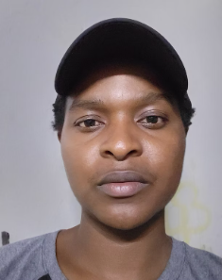


Team Members
PETER MACHARIA
CEO & LEAD DEVELOPER
SOLOMON KURIA
CO - FOUNDER & CTO
CHRISTINE WANJIKU
Chief Marketing Officer.
Notes:
14

Slide 15



Thank you!
Our Team
Contact Email
Visit Our Website
Proud to serve SMBs across Africa with MaliTrack.
mpeter778@gmail.com
https://MaliTrack.io
Notes:
15

